Slide 1

What is the Performance of Current Action Localization Methods?
--Le Yang
April 26th

Slide 2

CONTENTS
CONTENTS
1
Task Definition & Evaluation Metric
2
THUMOS’14 & ActivityNet

Slide 3
CONTENTS
PART ONE
Task Definition & Evaluation Metric

Slide 4
Task Definition
Temporal Action Localization :
For a target action class, predict not only its presence in a given video, but also its temporal location (i.e., the starting and ending times of each detected instance). --THUMOS’14 challenge

Slide 5
Evaluation Metric
The prediction should in the following format:
[video_name] [starting_time] [ending_time] [class_label] [confidence_score]
The time should be in seconds with one decimal point precision.
Time period of overlap
Interpolated Average Precision:
For test class C, given a descending-score-rank of videos, the AP(c) is computed as:
mAP: mean among whole classes

Slide 6
Evaluation Metric
In THUMOS’14, we set the threshold as 0.1:0.1:0.7, report score for each TH individually.
In ActivityNet, we set the threshold as 0.5:0.05:0.95, calculate the average of these scores.
Usually report scores at @50, @75, @95, @Avg
The testing sever using top 20 proposals to calculate scores.

Slide 7
CONTENTS
PART TWO
THUMOS’14 & ActivityNet

Slide 8
Search for Related Papers

Survey
Deep Learning for Action and Gesture Recognition in Image Sequences: A Survey Maryam Asadi-Aghbolaghi Springer Verlag, pp.539-578, 2017

ECCV 2018 & CVPR 2018
action localization / detection / segmentation
✶
arXiv
action localization / detection / segmentation

Slide 9
Search for Related Papers
I spent nearly 4 days to scan the related papers.
Connect each comparison to the original paper
Compare the experiment setting
(e.g., validation set VS test set)
Collect related researches
(e.g., action segmentation papers)

Slide 10
Dataset-THUMOS’14
THUMOS’14 dataset for Temporal Action Localization link
Training Data: 2755 trimmed videos from 20 sports action classes from UCF101.
Validation Data: 200 untrimmed videos from 20 action classes. Each video contains one or more action instances. Temporal annotations (start and end time) of all action instances is provided.
Background Data: 2500 videos, do not contain any instances of any of the 20 classes.
Test Data: 1574 untrimmed videos, 3358 action instances, only 213 of them contain action instances of interest.
Program Chair
Yu-Gang Jiang, Fudan University
Jingen Liu, SRI International
Amir R. Zamir, UCF
George Toderici, Google Research
General Chair
Ivan Laptev, INRIA
Mubarak Shah, UCF
Rahul Sukthankar, Google Research

Slide 11
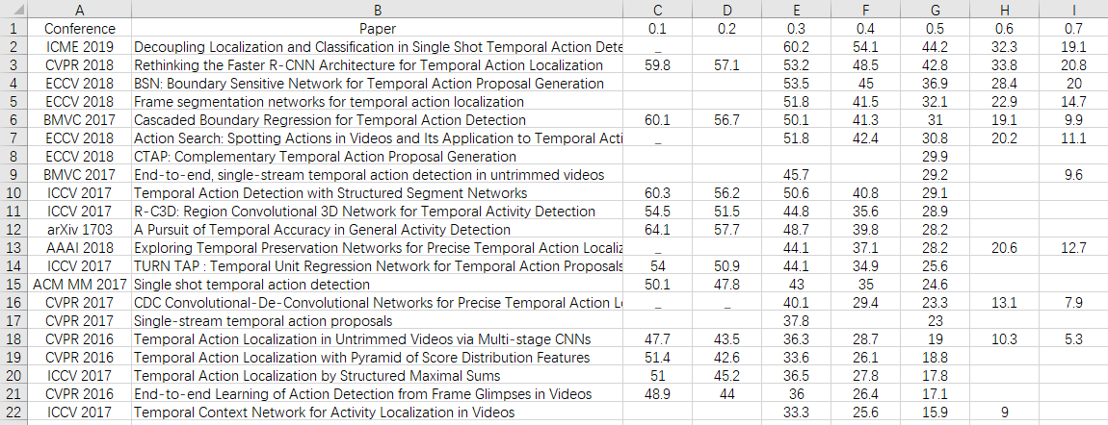
Performance on THUMOS’14
Performance of supervised methods in recent years

Slide 12
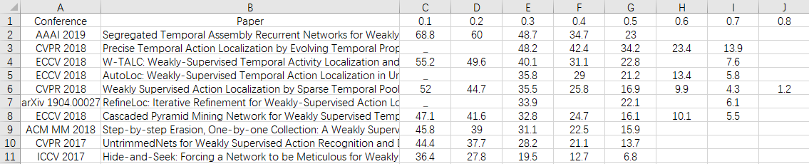
Performance on THUMOS’14
Performance of weakly supervised methods in recent years

Slide 13
Dataset-THUMOS’15
THUMOS’15 dataset for Temporal Action Localization link
Training Data: a subset of UCF101 action dataset with 20 action classes.
Validation Data: 200 videos from 20 action classes.
Background Data: 2980 videos.
Test Data: 5613 temporally untrimmed videos.
THUMOS’15 is barely used. On the contrary, THUMOS’ 14 is popular.
Program Chair
Alexander Gorban, Google Research
Haroon Idrees, UCF
Yu-Gang Jiang, Fudan University
Amir R. Zamir, Stanford University
General Chair
Ivan Laptev, INRIA
Mubarak Shah, UCF
Rahul Sukthankar, Google Research

Slide 14
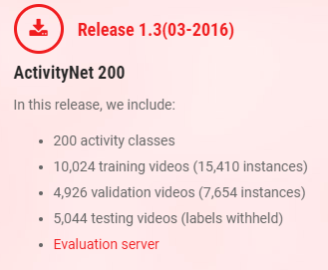
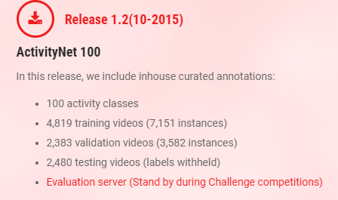
ActivityNet
link
Most researches use Release 1.3

Slide 15
ActivityNet
link
For ActivityNet 2016~2019, following organizers occurred more than 3 times
Bernard Ghanem[1], Juan Carlos Niebles[2,3],
Cees Snoek[4], Fabian Caba Heilbron[1],
Humam Alwassel[1], Victor Escorcia[1]
1: King Abdullah University of Science and Technology
2: Stanford University
3: Universidad del Norte
4: Universiteit van Amsterdam

Slide 16
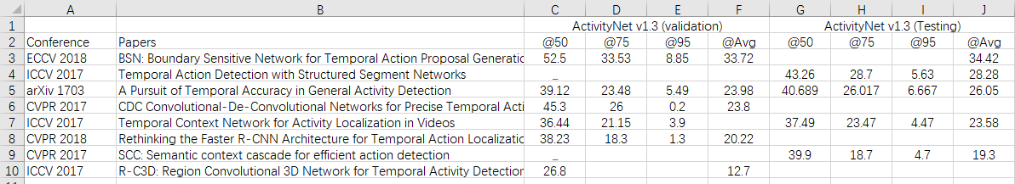
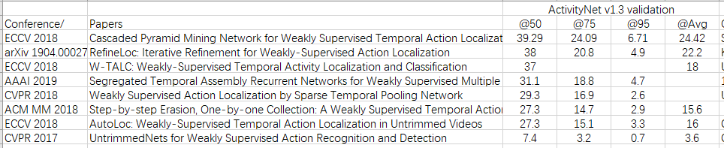
Performance on ActivityNet
Full supervision
Weak supervision

